Slide 1
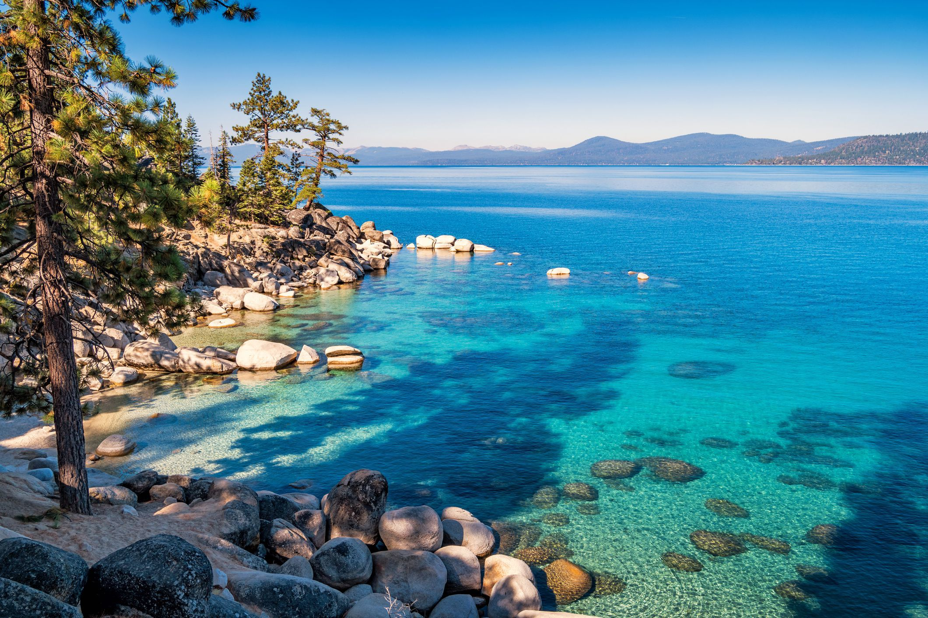


Terms Extension Opportunity Assessment
7 2024

Slide 2
I wasn't able to search within the uploaded files, but I can still provide a comprehensive summary based on the images you have listed. Here it is:
---
### Situation Summary for American Water
We understand that American Water is looking to optimize its working capital position with Taulia’s holistic Working Capital Management platform. Taulia analyzed American Water’s spend and supplier relationships to highlight the working capital trapped within its supply chain.
**Highlights:**
- **Working Capital Potential:**
* Total potential working capital within American Water’s existing supply chain is ~$250M based on 100% extension adoption.
- **Impact to Discounts:**
* Significant discount potential with peak liquidity demand at APR 6 with $1.4M gross yield.
- **Industry Analysis:**
* Taulia expects American Water should be able to generate $617M across its top-10 largest supplier industry groups.
By aligning payment terms with industry norms and leveraging Taulia’s platform, American Water can unlock significant working capital and efficiency gains.
---
This format should fit well into a single slide for a presentation. Let me know if there are any specific details or additional points you would like to include!
© 2023 Taulia LLC. Confidential information. Do not distribute.

Slide 3
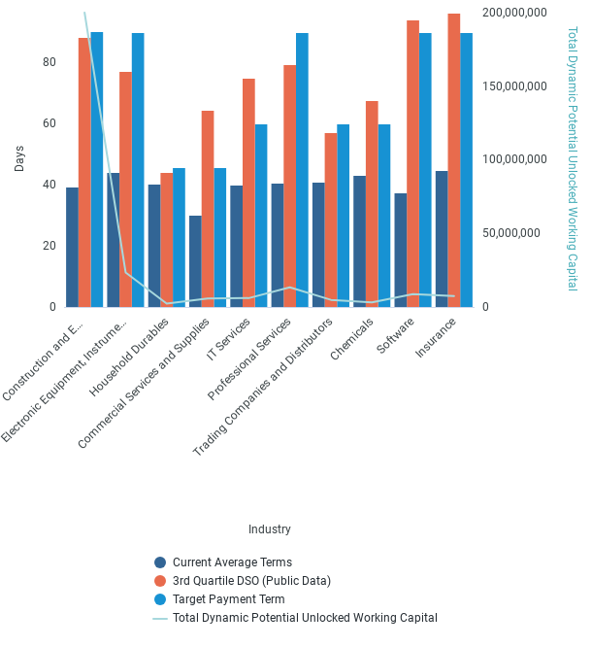
Industry Term Comparison
© 2023 Taulia LLC. Confidential information. Do not distribute.

Slide 4
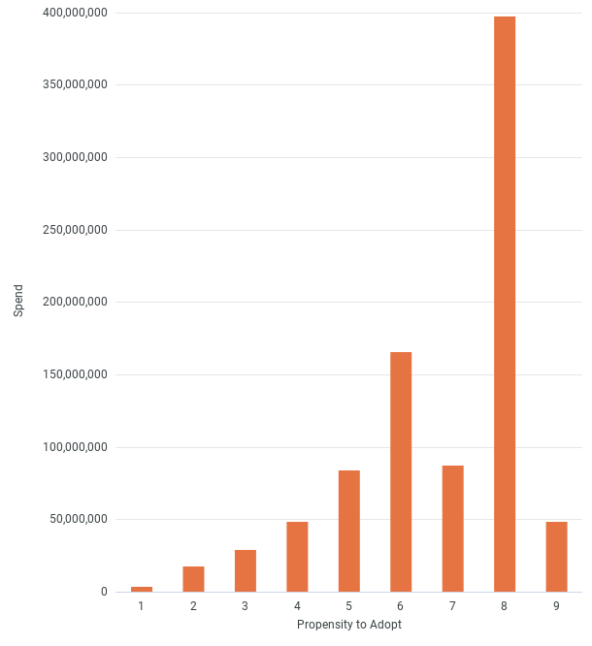
Card Adoption
© 2023 Taulia LLC. Confidential information. Do not distribute.

Slide 5
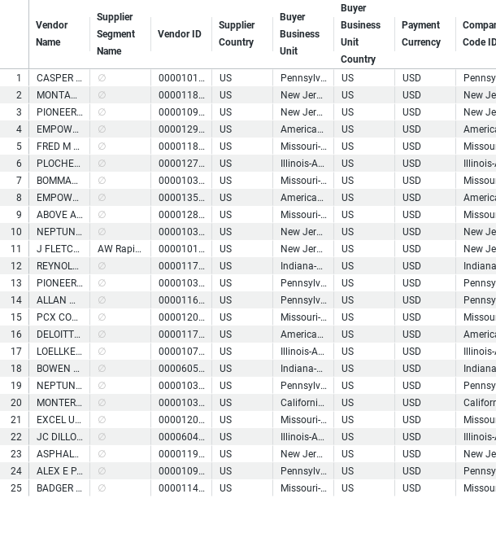
Top WC Potential Suppliers
© 2023 Taulia LLC. Confidential information. Do not distribute.

Slide 6
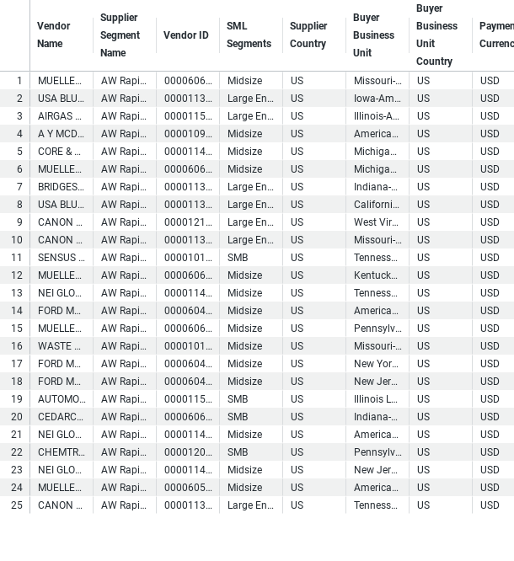
Buyer - Payables Planner Supplier List
© 2023 Taulia LLC. Confidential information. Do not distribute.

Slide 7
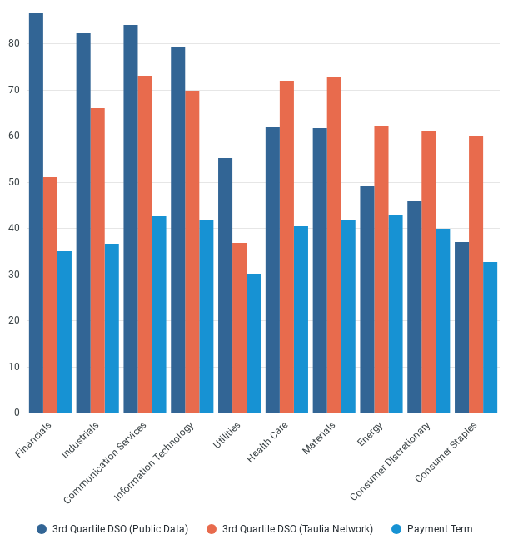
Supplier Payment Terms Comparison
© 2023 Taulia LLC. Confidential information. Do not distribute.

Slide 8
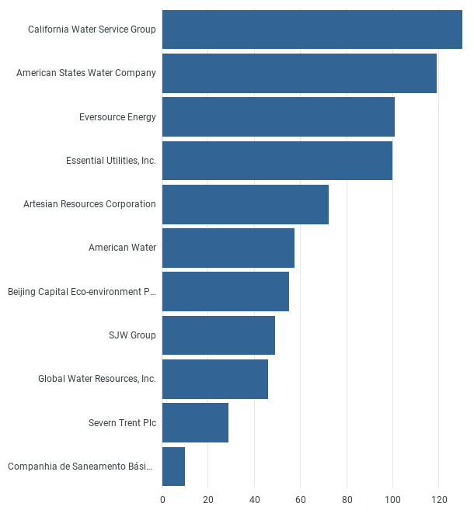
Peer DPO
© 2023 Taulia LLC. Confidential information. Do not distribute.

Slide 9
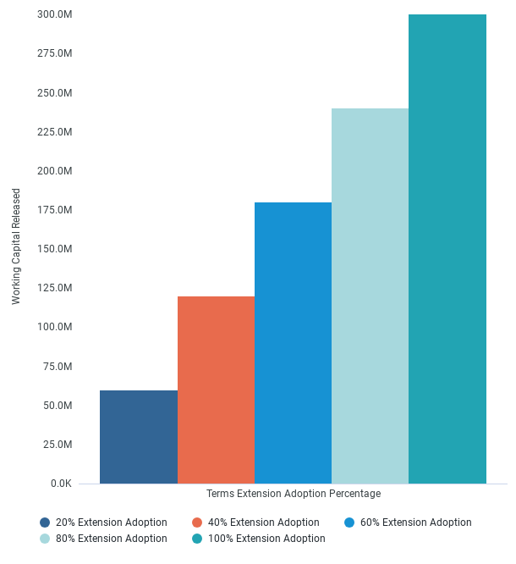
Working Capital Released
© 2023 Taulia LLC. Confidential information. Do not distribute.

